Slide 1
PHASE ONE PROJECT
MOVIE INVESTMENT ANALYSIS PROJECT

Slide 2
INTRODUCTION
Film Industry is diverse, dynamic and a fast evolving sector with transcending potential.
This project explores the possibilities of investing and aims to give insights and recommendations on whether it is a viable business.
The beneficial stakeholders are scholars, filmmakers, and entrepreneurs like in this case, Microsoft.

Slide 3
Data Understanding, Preparation and Analysis
The data in this project is from different reputable movie databases API like IDBM, Bom Movies, Rotten Tomatoes and includes reviews and ratings from users.
The data sets has information on movie title, genre, ratings and reviews, studio, domestic and foreign gross, year, runtime and number of votes.
Descriptive analysis and statistics for key features used for this analysis include:
movie runtime minutes mean and standard deviation.
Ratings and review mean and standard deviation.
Genre distribution.

Slide 4
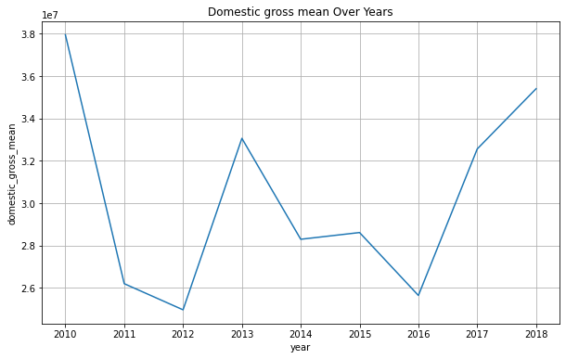
Data visualization

Slide 5
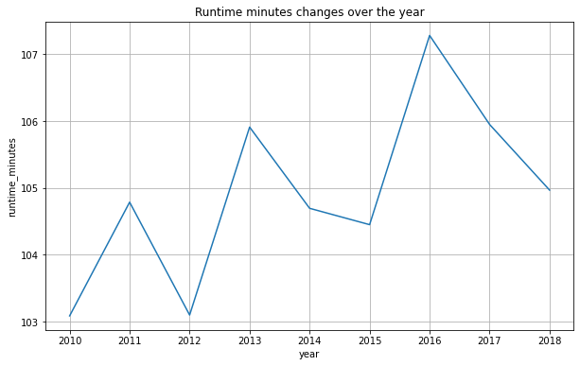
Data visualization

Slide 6
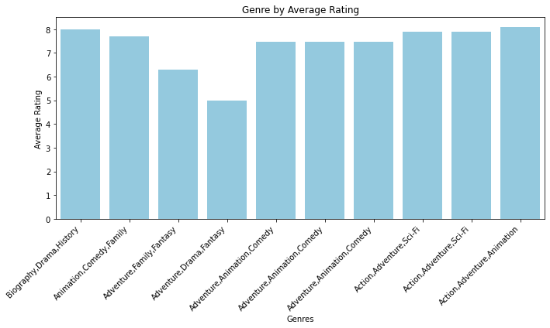
Data visualization

Slide 7
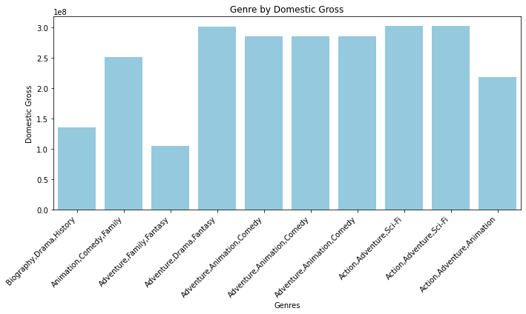
Data visualization

Slide 8
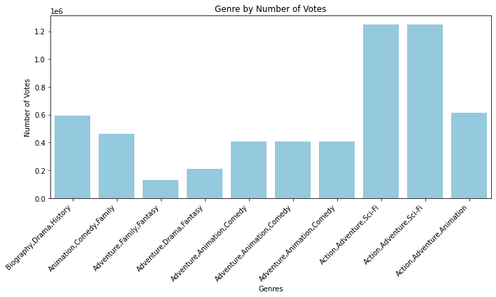
Data visualization

Slide 9
Findings and Recommendations
Domestic gross income distribution over the year in the beginning years there was drastic upward and downward changes, however from 2016 it has taken and upward trajectory.
Movie runtime minutes has fluctuated over the years with 2016 having the climax and downward movement after that year. While this took a downward shift the domestic income took an upward shift. This shows that runtime does not does directly correlate with gross income being generated.
The high ranking genres using the criteria of rating, number of votes and domestic gross are action, adventure, Sci-Fi, animation, drama, fantansy, comedy and or a combination of the mentioned genres.

Slide 10
Conclusion
The film industry has great possibilities of growth because it dynamic, evolving, vast and robust. It has diverse genres that give coverage to a diverse target group based on preferences from comedy, action, adventure, Sci-Fi, animation among others. The industry is able to generate income widely in this case both domestic and foreign income. In conclusion it a viable business venture.

